Slide 1
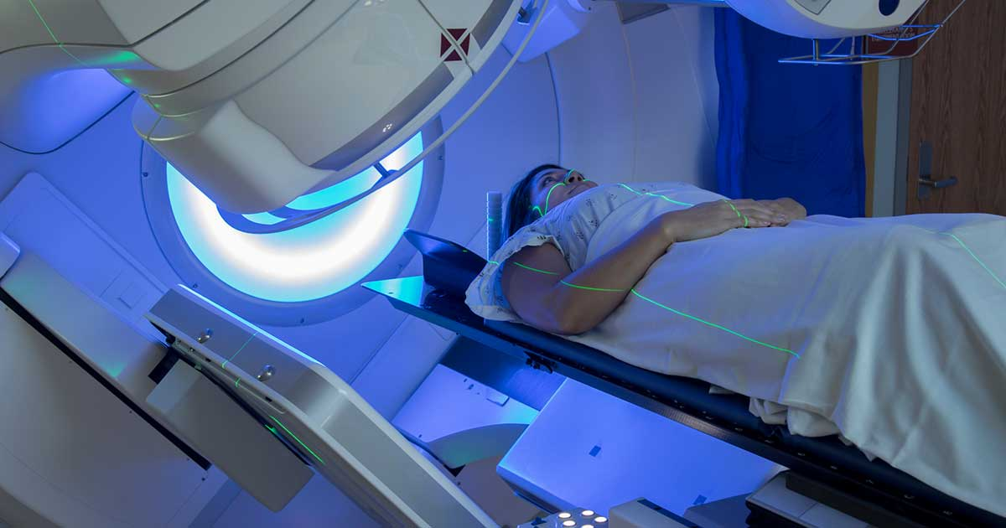
Introduction and Workflow of the Radiation Oncology Department
Pushpraj Bhardwaj, M.Sc. in Medical and Radiological Physics,
Center for Medical and Radiation Physics,
National Institute of Science Education and Research, Bhubaneswar

Slide 2


Contents
Radiation Oncology team
Roles of different individuals
Workflow
Personal Monitoring Devices
Radiation Therapy and Diagnostic Machines

Slide 3
Radiation Oncology Team
Radiation Oncologist
Medical Physicist
Radiation Therapy Technologists
Nursing and Helping Staff
Radiation Safety Officer

Slide 4
Role of Medical Physicist
Quality Assurance: Ensuring accurate and safe operation of radiation equipment through regular quality checks.
Treatment Planning: Collaborating with oncologists to make patient specific plans.
Dose Calculation: Accurately calculating radiation doses to achieve tumor targeting.
Technology Advancement: Staying updated with the latest technological advancements, including imaging techniques and treatment planning systems.

Slide 5
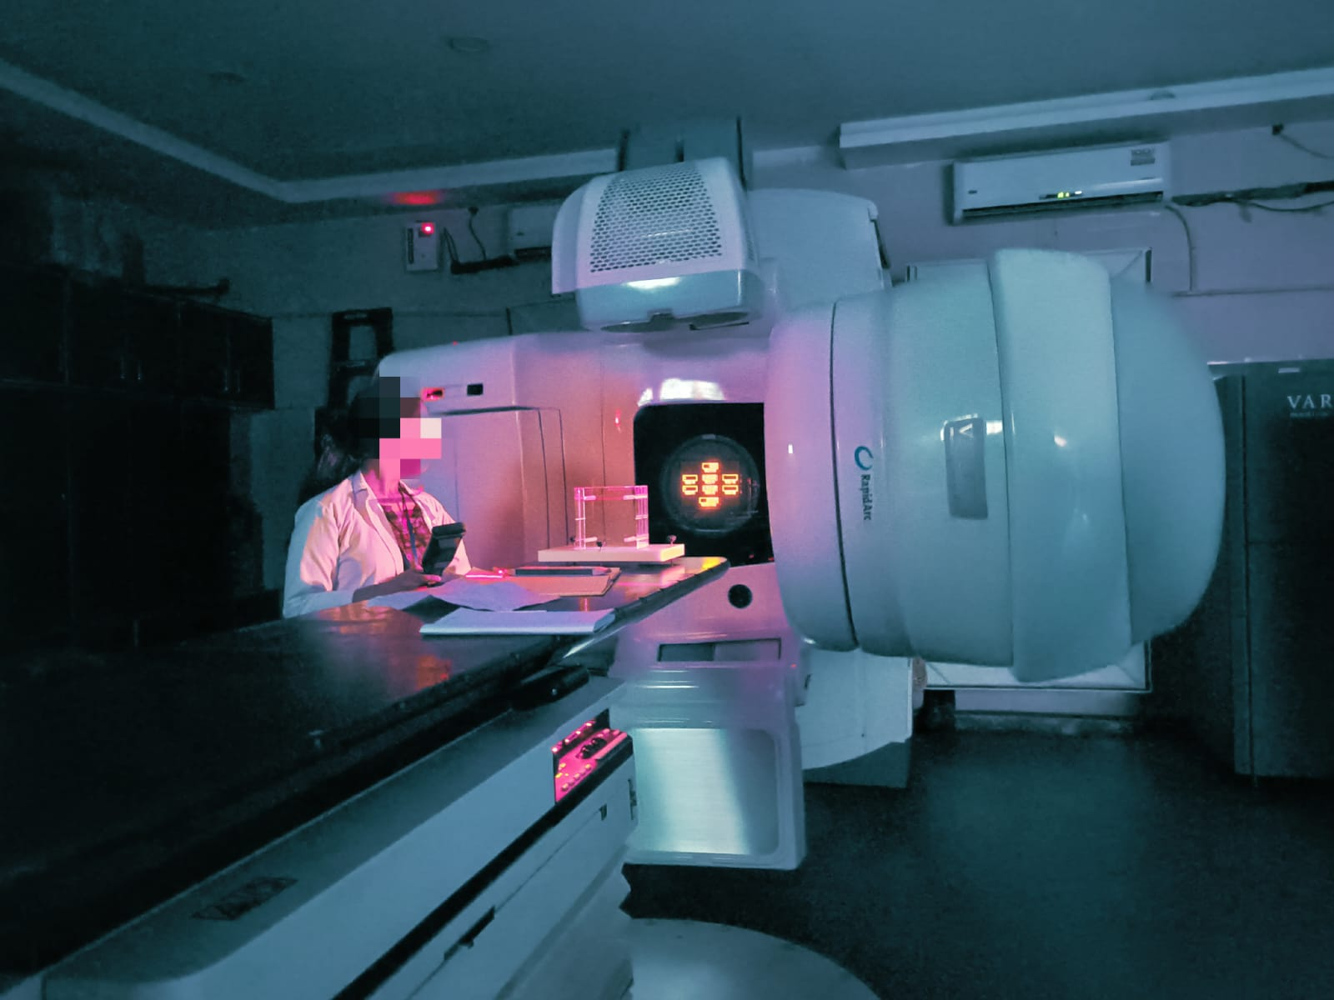
A Medical Physics intern performing Daily Quality Assurance of a Medical LINAC at Dr. BBCI. (Photo used with permission)

Slide 6
Role of Radiation Safety Officer
Regulatory Compliance: Ensuring adherence to radiation safety regulations and guidelines of AERB and IAEA.
Monitoring Exposure: Regularly monitoring radiation exposure levels for both staff and patients.
Commissioning and decommissioning of machines.
Radiation Protection: Implementing effective shielding, safety protocols, and safety equipment to minimize radiation exposure risk.
Incident Management: Investigating and managing any radiation-related incidents, accidents, or unsafe practices to prevent reoccurrence.

Slide 7
Role of Radiation Oncologist
Patient Evaluation: Reviewing patient history, evaluating the extent and location of tumors and determining treatment modalities.
CT Image Contouring: Precisely defining target volume and OARs on CT images.
Progress Monitoring: Regularly accessing the patient progress and make plan adjustments if required.
Collaborative Care: Working within a multidisciplinary team.
Treatment Administration: Overseeing the treatment delivery and managing side effects.

Slide 8
Role of Radiation Therapy Technologist
Patient Preparation: Positioning patients accurately for radiation therapy and ensuring patient comfort.
Equipment Operation: Operating and maintaining radiation therapy machines.
Record keeping: Maintaining records of treatment sessions, including machine settings.
Monitoring Treatment: Monitoring patients during radiation therapy sessions
Following treatment plans and ensuring precise radiation beam delivery.

Slide 9

Role of Nursing Staff
Assisting in treatment procedures.
Monitoring patient reactions.
Patient education and emotional support.

Slide 10
Workflow of Cancer Hospital
Registration
OPD
Tumor Board
Radiation Oncology Department
Simulator
TPS Planning
Therapy Unit
Immobilization
CT/MRI scan
Image Fusion
Volume Delineation
Treatment Planning
Plan verification (QA)
Pre-Treatment imaging
Treatment

Slide 11
Workflow of Radiation Oncology Department
Tumor Board
Immobilization
Simulation
Treatment Planning
Plan Evaluation
Quality Assurance
Treatment Delivery
Consisting of oncologists
Mould room facility for case specific immobilization devices
CT/ MRI or both followed by image fusion
Patient specific QA for SRS/SRT/SBRT cases
By senior medical physicists and oncologists
After the contouring is done by oncologist

Slide 12
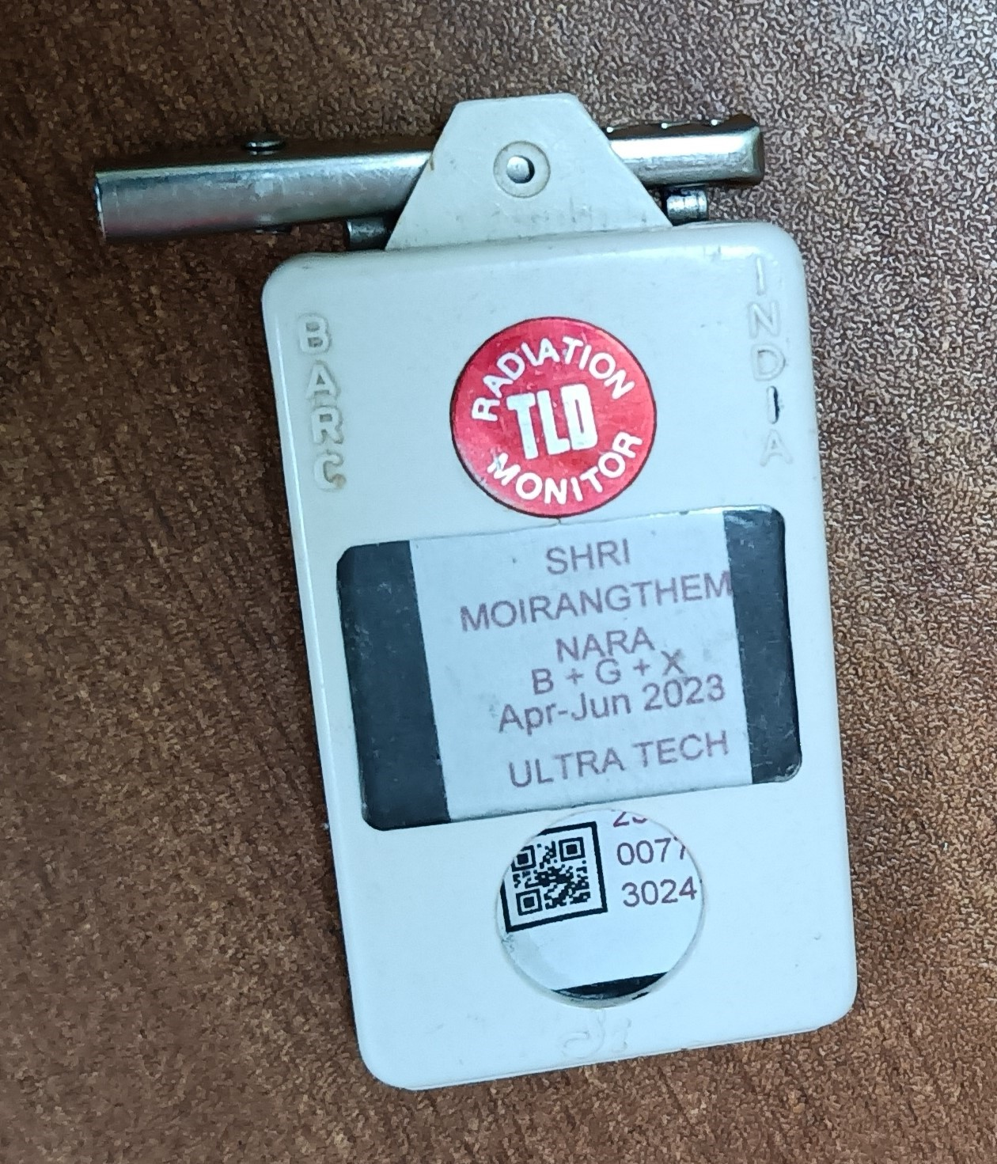
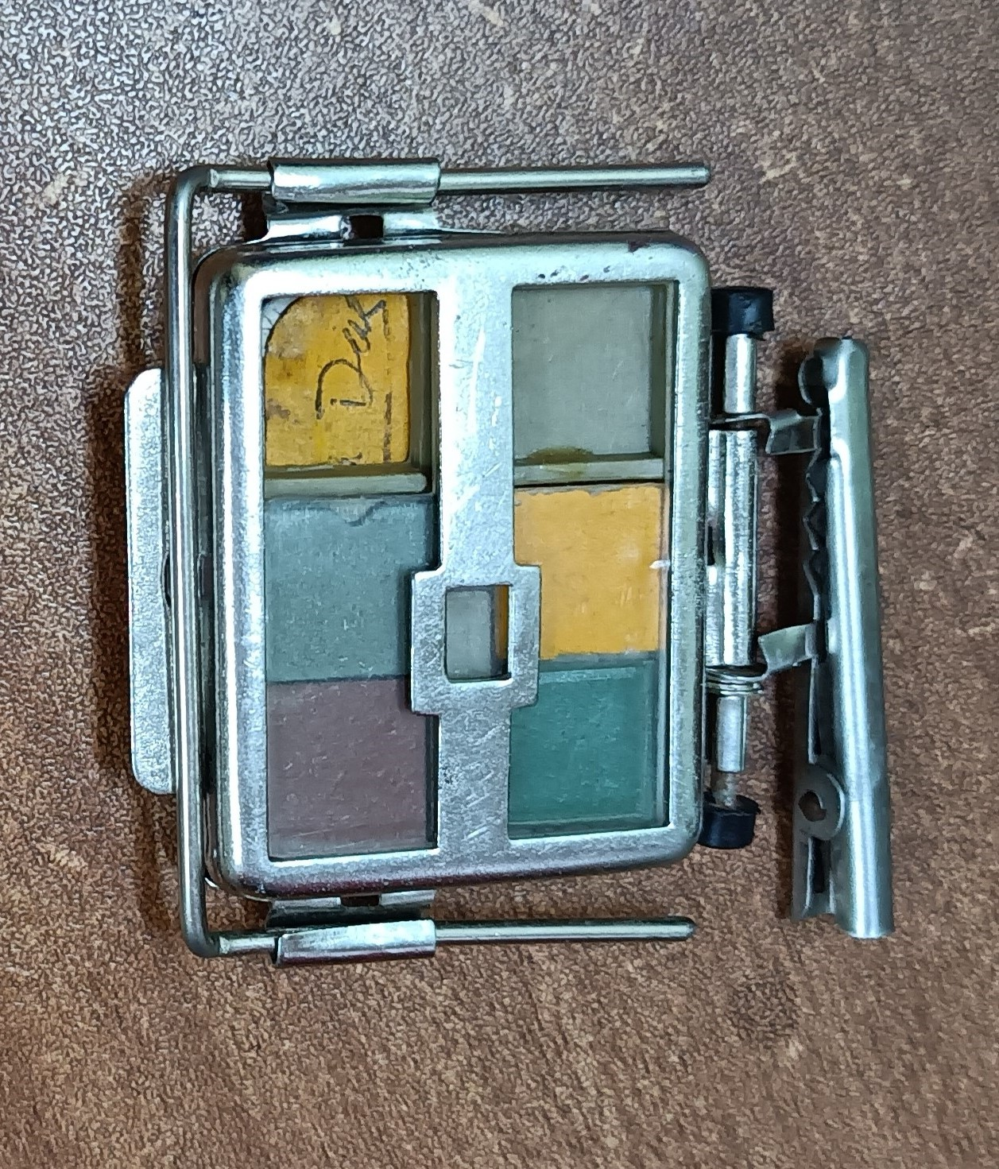
Personal Monitoring Devices
Passive Dosimeters are preferably used in Hospital settings to monitor radiation exposure to Radiation workers and patients.
Most commonly used dosimeters:
Advantages of TLD over Film dosimeter:
Cost effective
Reusable
Low effect of humidity
Highly sensitive
Al and Cu filter (X-rays and Gamma-rays)
Plastic filter (Beta rays, X-rays, Gamma-rays
Open filter(all types of radiation)
6 filters for different types of radiation
A TLD badge
A Film dosimeter badge

Slide 13
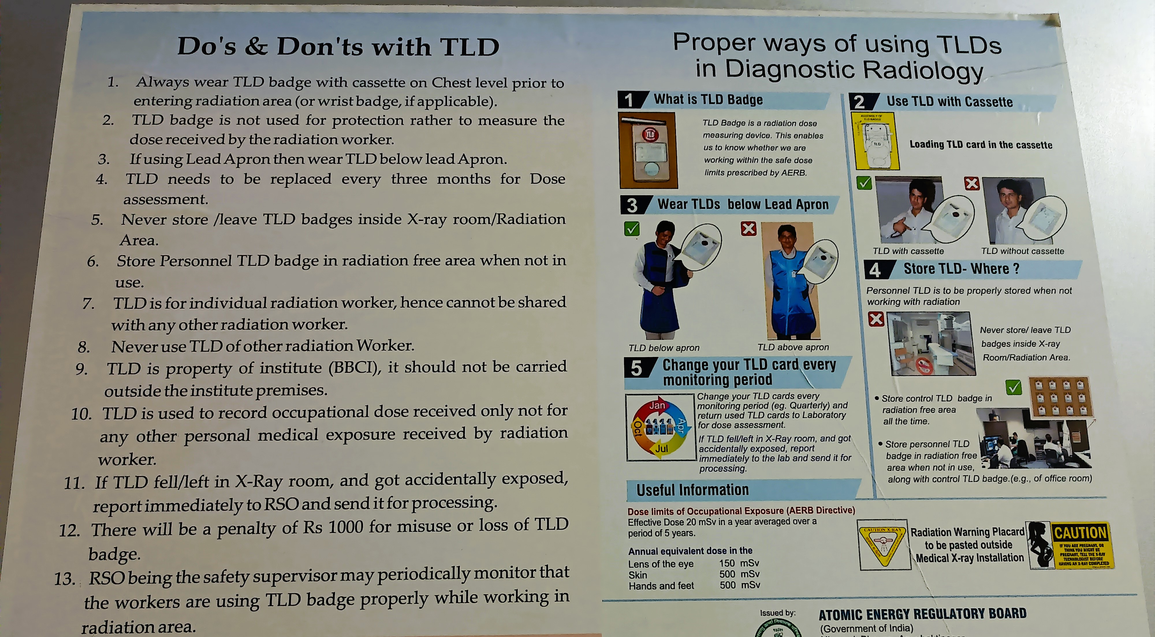





Importance of a TLD badge

Slide 14
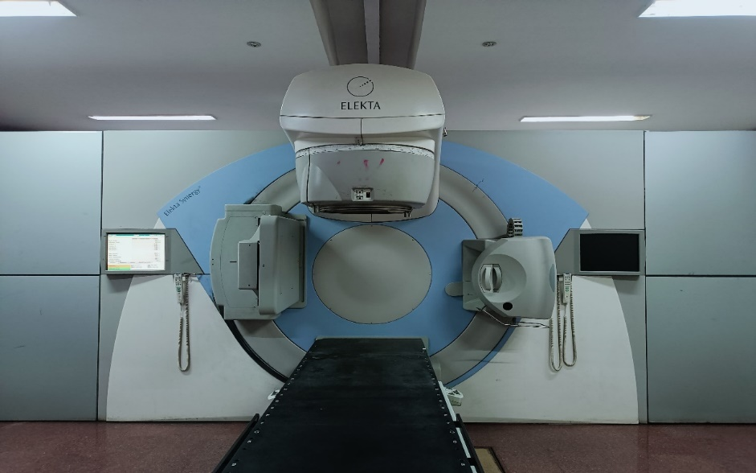
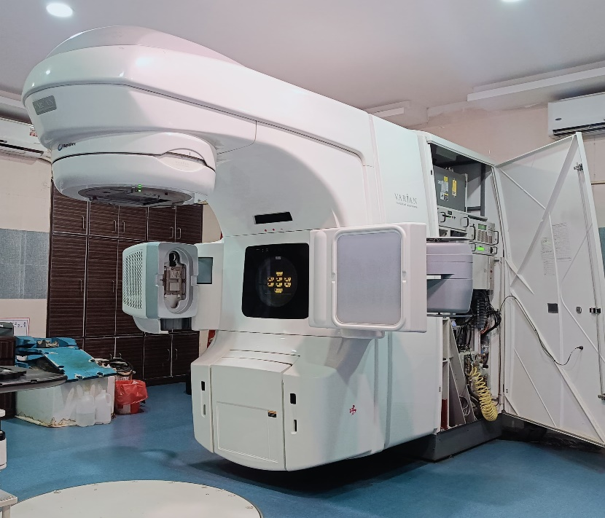

Radiation Therapy and Diagnostic Machines
Factors on the basis of which we can differentiate between two Linear accelerators
LINAC (Elekta Synergy) at BBCI
LINAC (Varian Trilogy) at BBCI
MLC
Couch Material
Couch Capacity
Photon Energy
D_{max}
Electron Energy
SSD
Treatment Techniques
Wedge
40 Pairs (each of width 1cm)
Carbon Fiber
200 kg
4 MV, 6 MV
1 cm for 4 MV
1.5 cm for 6 MV
NA
100 cm
Conventional, 3DCRT, IMRT, SRS/SRT
60⁰ Motorized Wedge
60 Pairs (Central 40 pairs of 0.5cm width) (Outer 20 pairs of 1cm width)
Carbon Fiber
200 kg
6 MV, 15 MV, 6 MV FFF
1.5 cm (6 MV) , 1.3 cm (6 MV FFF)
3 cm (15 MV)
4 MeV, 6 MeV
100 cm
Conventional, 3DCRT, IMRT, SRS/SRT
Enhanced Dynamic Wedge (15⁰, 30⁰, 45⁰ and 60⁰)

Slide 15
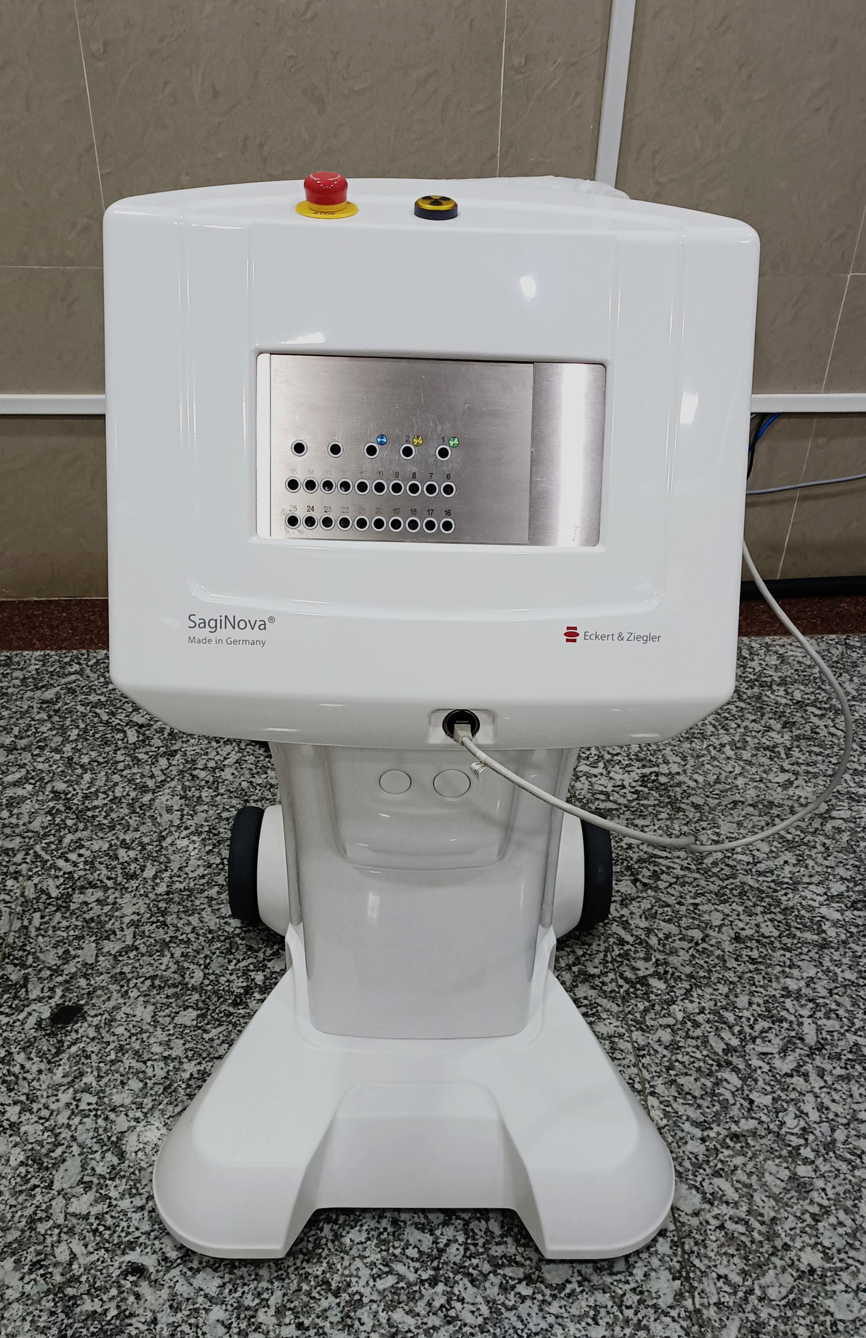
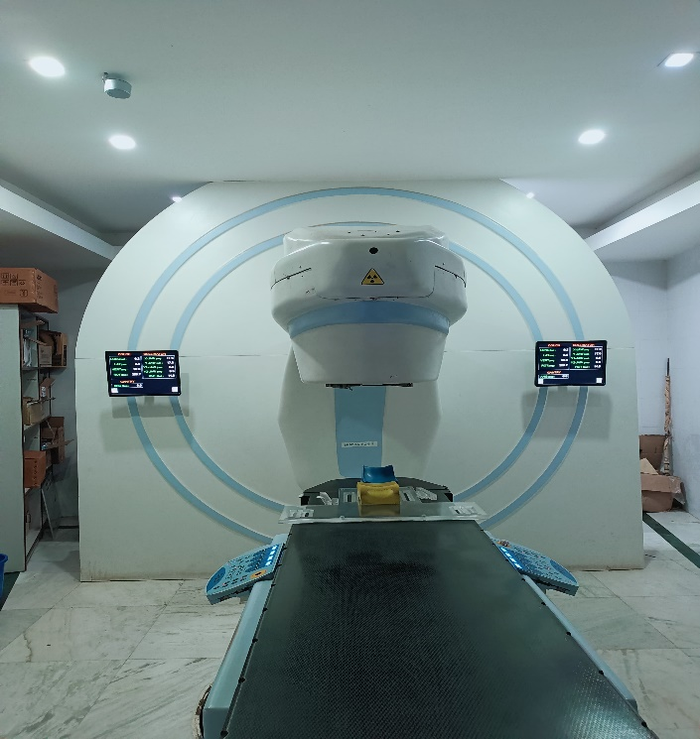
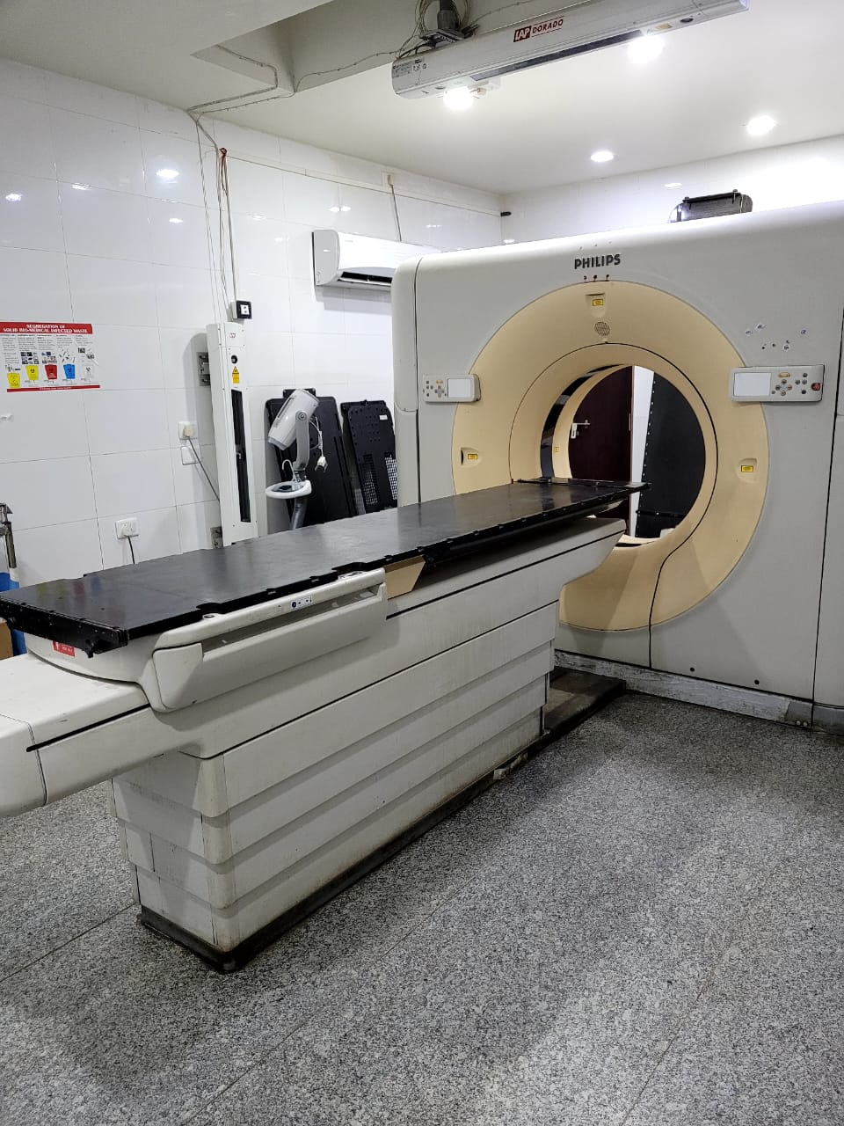
Radiation Therapy and Diagnostic Machines
HDR Brachytherapy source delivery machine (25 channels)
Eckert & Ziegler – SagiNova at BBCI
Telecobalt unit (Bhabhatron II TAW)
TAW – Tungsten Asymmetric Wedge at BBCI
CT Simulator (Philips) at BBCI

Slide 16
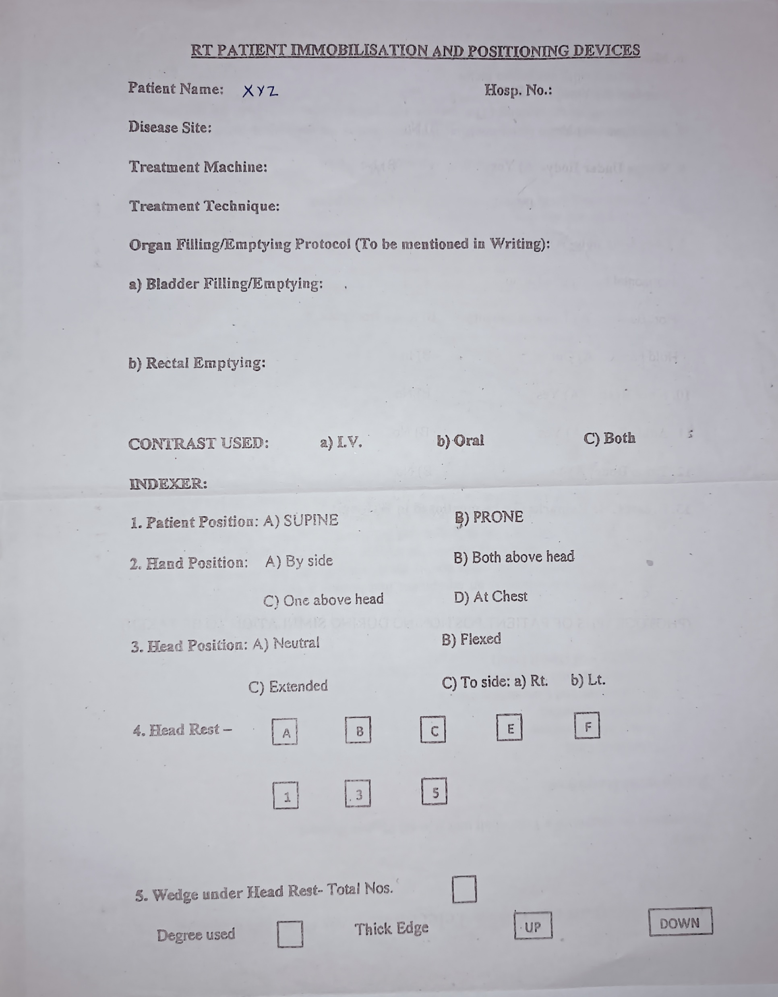
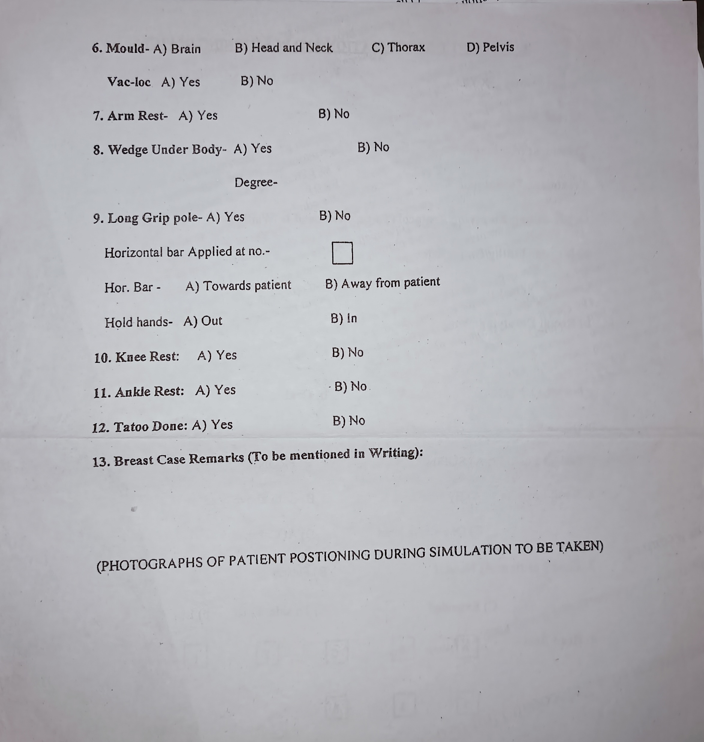
First treatment specific record: Patient immobilization and positioning information, recorded at the time of CT simulation and sent along with the patient’s file to the treatment delivery machine.

Slide 17
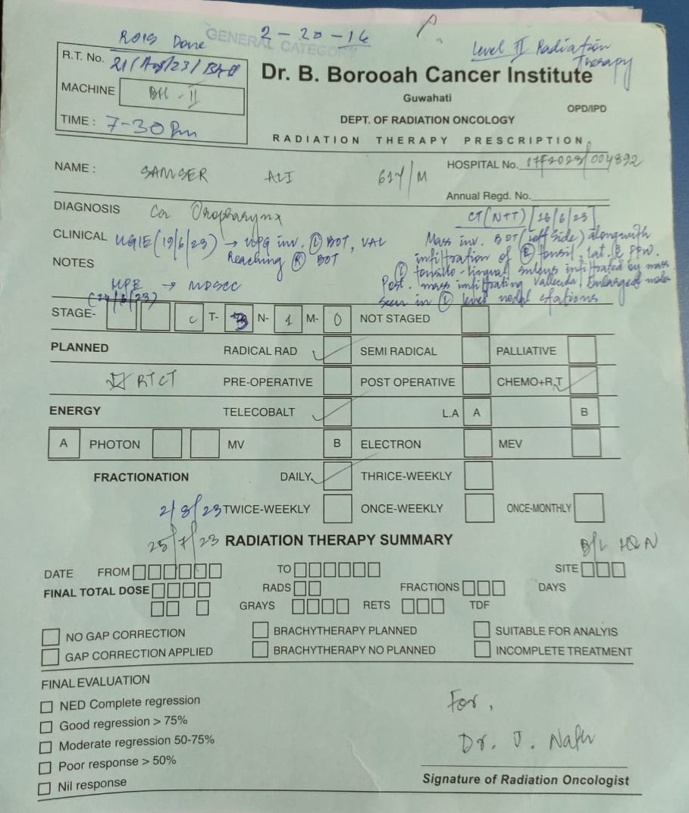
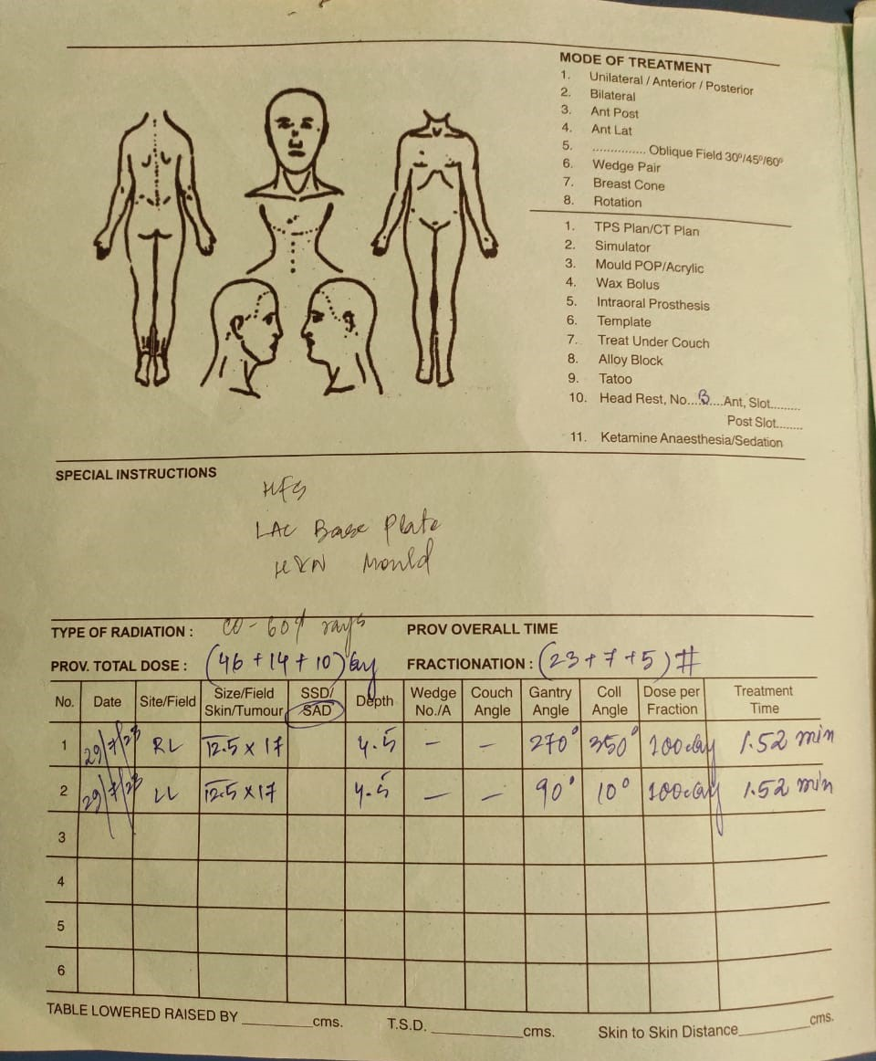
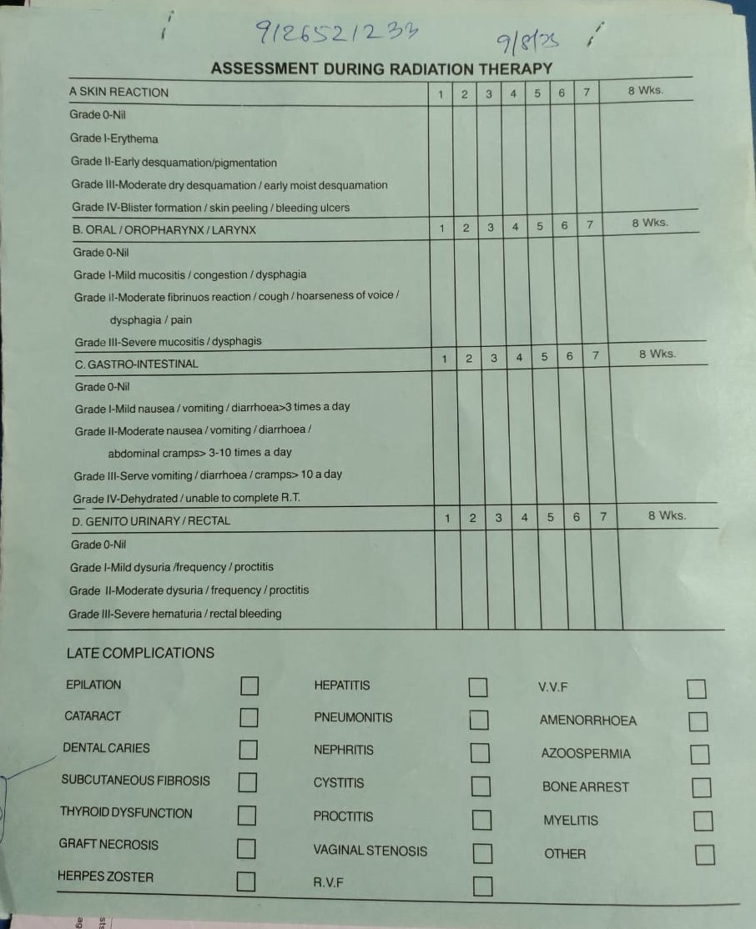
RT file: Where all the record about patient’s medical condition, prescribed dose, Dose fractions, Immobilization used, Treatment time (for Telecobalt) and Monitoring units (for LINAC), is maintained.

Slide 18
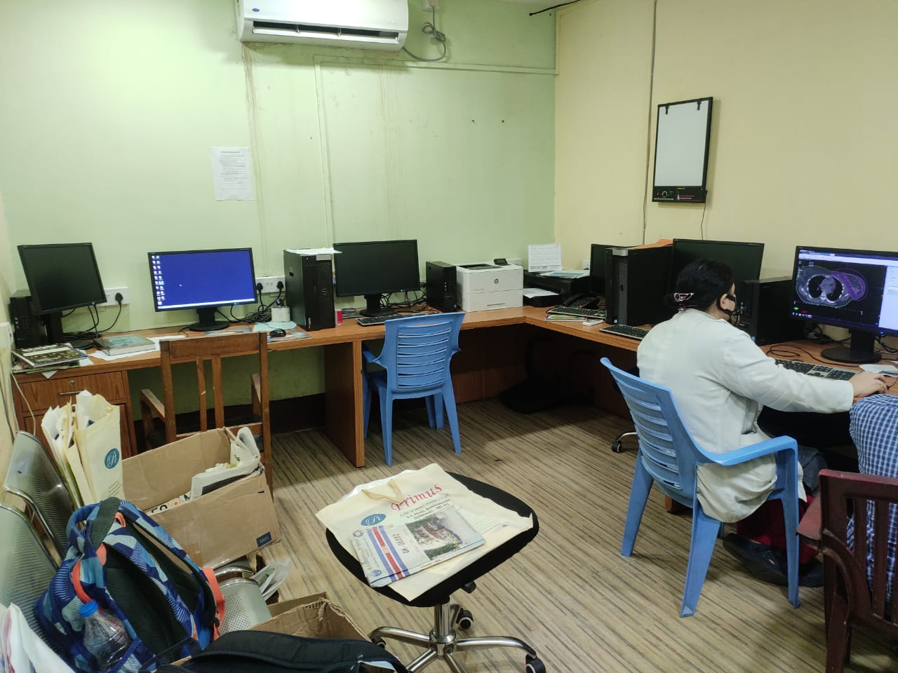
This is how a typical TPS planning room looks like where both Medical Physicists and Oncologists work in collaboration.

Slide 19
THANK YOU

